Slide 1
TV Programs Schedule Tracker:
With Insights and Visualization

Slide 2
CONTENTS
The Team
Business Understanding
Data Preparation
Methodology
Data Visualization
References

Slide 3
THE TEAM
Yuva Krishna Kishore Inapala
Bhaskara Vijaya Sai Swamy Vanacharla
Daraveni Nithin Yadav
Shruthi Prabakaran
Team Lead
Data Engineer
Data Tester
BI Developer

Slide 4
BUSINESS UNDERSTANDING
The primary goal is to create a centralized repository for TV schedules, capturing data on daily programs across various channels and time slots.
Enable the extraction of valuable insights from the collected data through analytics and visualization.

Slide 5
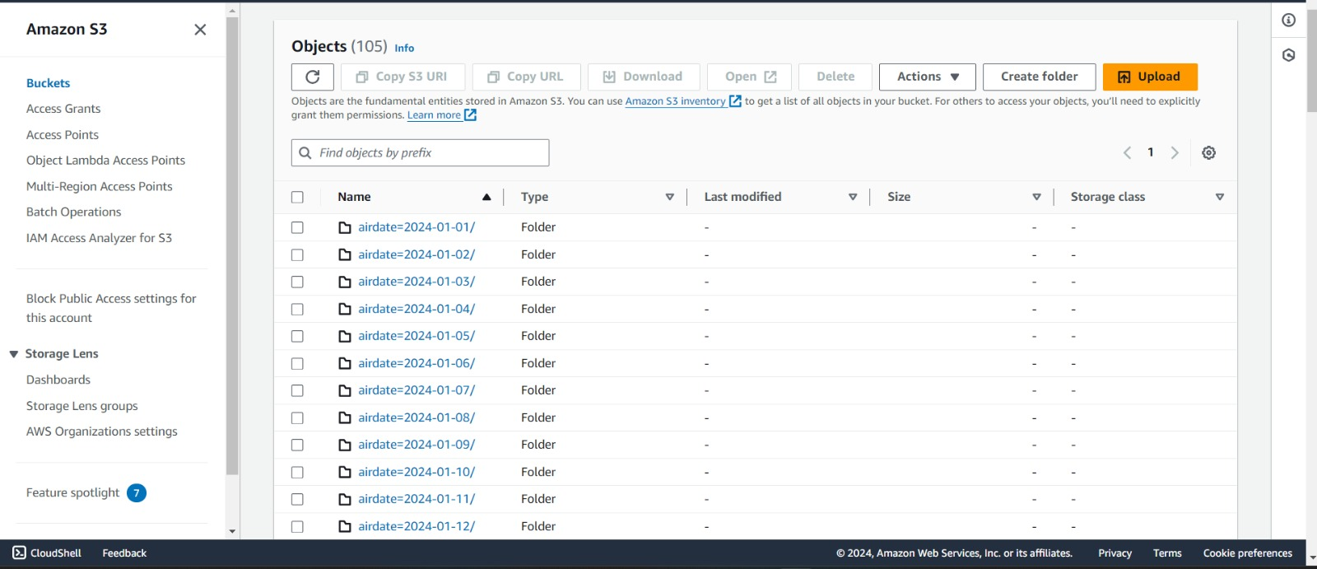
DATA PREPARATION
Data Identification: This project identified TV show schedule data from the TVMaze API as the relevant dataset for analysis.
Data Staging: An AWS environment was created, including the utilization of Amazon S3 to store the TV show schedule data fetched from the API.

Slide 6
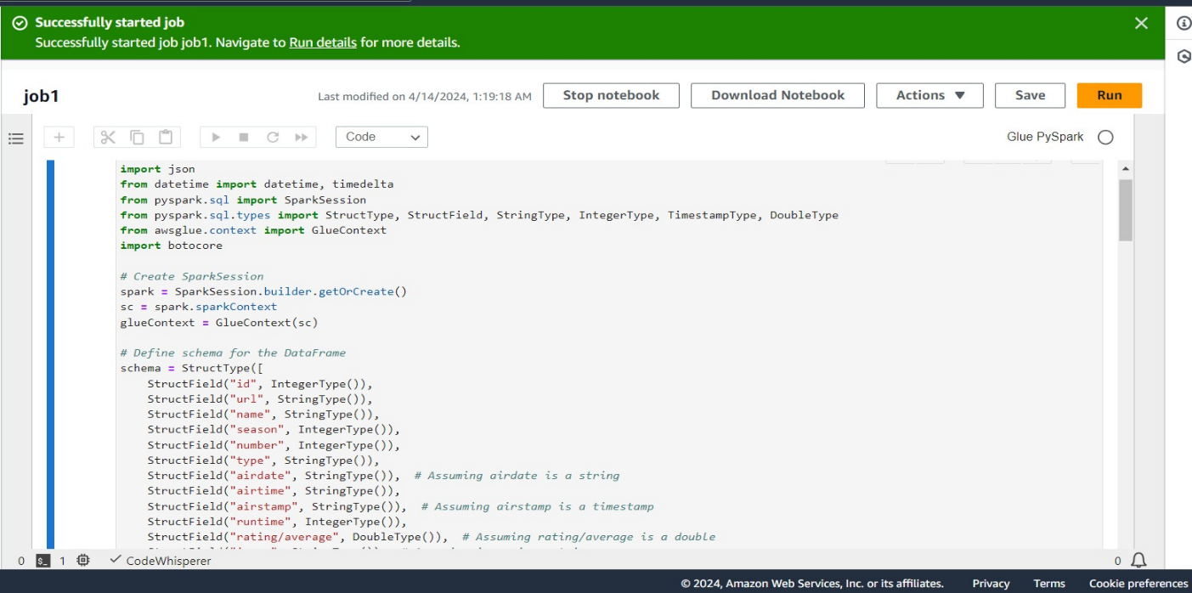
METHODOLOGY
Data Ingestion: Scripts were developed to load the unprocessed TV show schedule data into the designated S3 bucket directly from the TVMaze API.
Data processing: Implemented data processing pipelines using Apache Spark (leveraging PySpark) to clean and transform the raw TV show schedule data into a structured format.

Slide 7
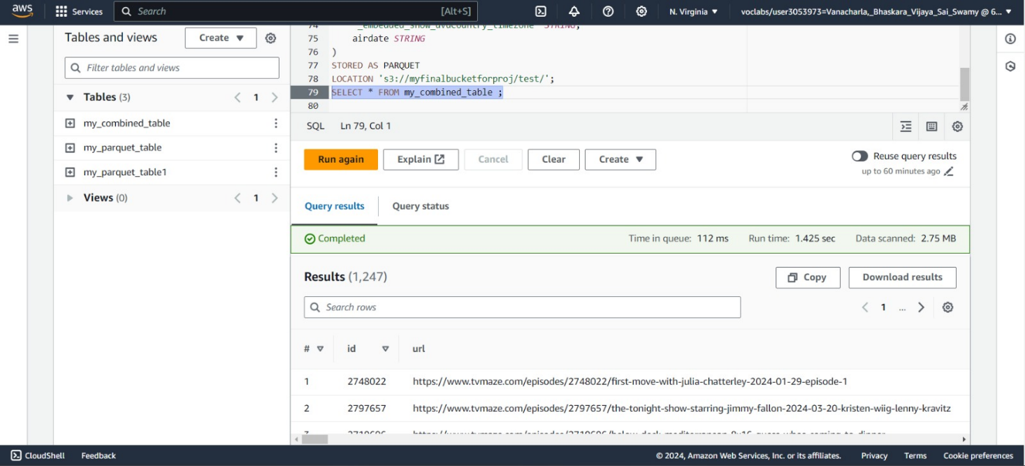
METHODOLOGY
Athena Integration: Amazon Athena was integrated into the project to facilitate querying of the processed TV show schedule data directly from the S3 bucket using SQL queries.
Query Optimization: QL queries executed in Amazon Athena were optimized for effective performance and analysis to ensure efficient querying of the dataset.

Slide 8
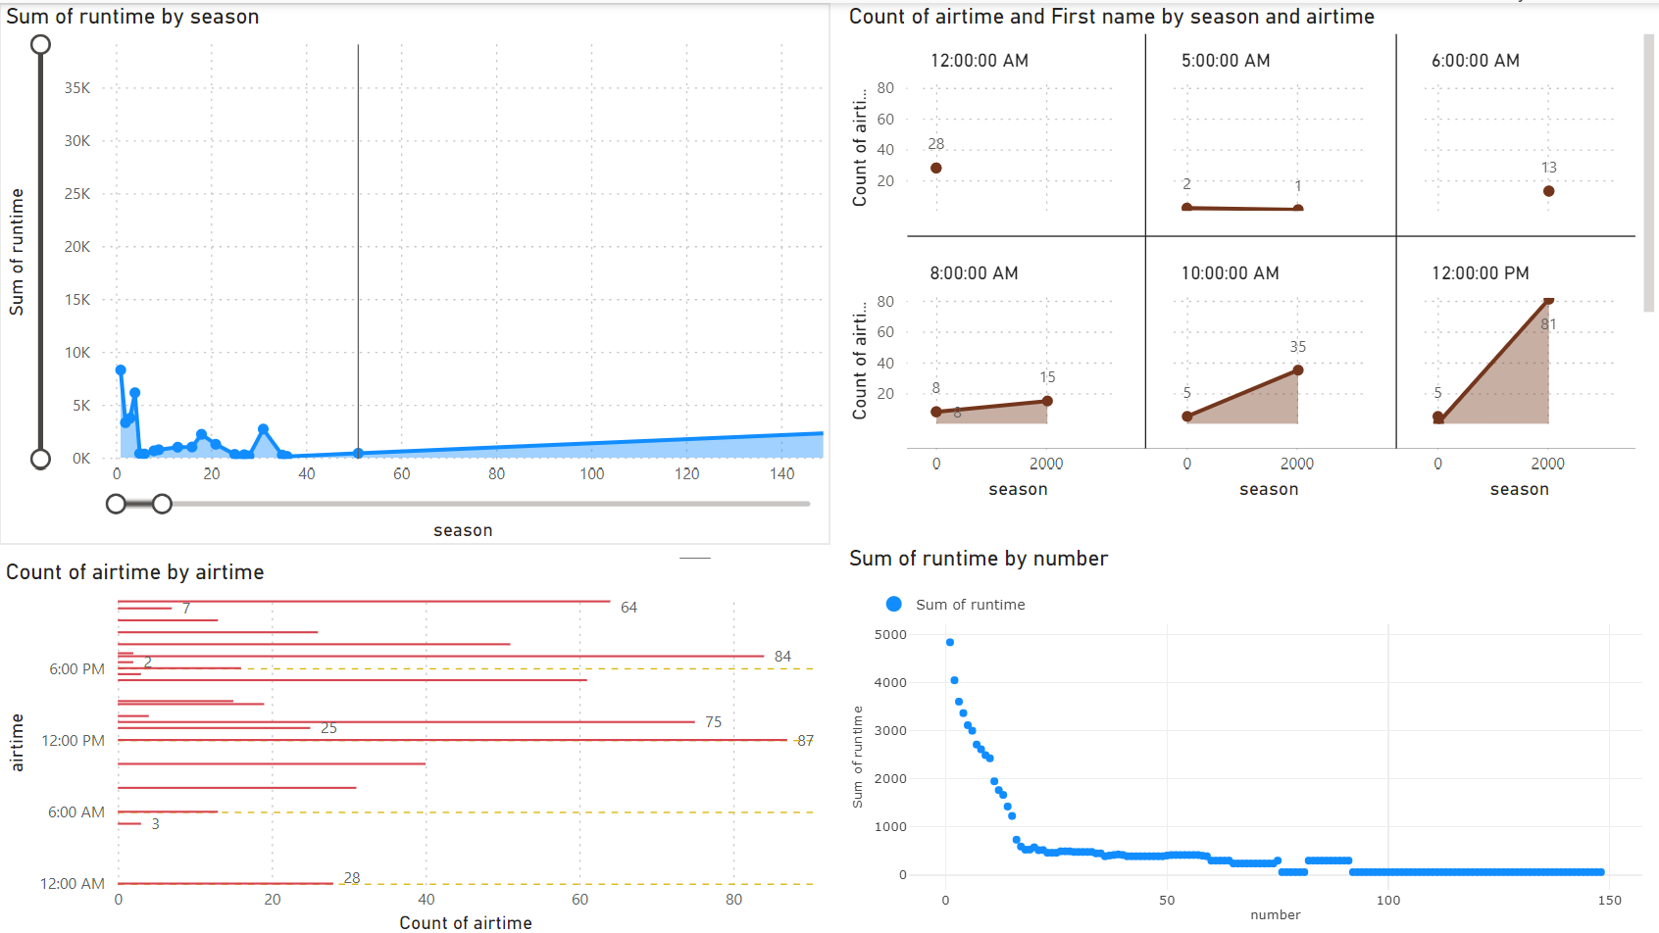
DATA VISUALIZATION
Power BI Integration: Power BI was linked to Amazon Athena to enable reporting and visualization of the queried TV show schedule data.

Slide 9
REFERENCES
https://github.com/helenamin/DEB-TV-MAZE
https://learn.microsoft.com/en-us/power-bi/fundamentals/
https://www.tvmaze.com/api
https://docs.aws.amazon.com/glue/
https://docs.aws.amazon.com/AmazonS3/latest/userguide/Welcome.html

Slide 10
THANK YOU!

